Slide 1
Affordable Housing in Kent County
MADS Milestone 1 Project
Alan Fehsenfeld | Koon Leong Ho | George Thio
February 3, 2021

Slide 2
Table of Contents
Executive Summary

Slide 3
Executive Summary
Background
A study published by the Terner Center of the University of California at Berkeley found that housing stability to social improvement as it allows the under privileged to focus on education, employment, and other dimensions of economic mobility. It promotes investments in professional development helped them to keep their jobs by reducing involuntary moves.
Promoting affordable housing, therefore, has the significant positive impact on the community.
The Federal Low Income Housing Tax Credit Program (LIHTC) provides tax credit to promote development of affordable rental housing. In Michigan, this is administered by the Michigan State Housing Development Authority (MSHDA). Projects under the scheme are awarded based on the quality of the proposal and the location as rated by the LIHTC Scoring Criteria. The criteria takes into consideration the following factors:
Proximity to Transportation
Proximity to Amenities
Enterprise 360 Opportunity 360 Score
Walk Score
Distance from Employment Centers
Located in Neighborhood Investment Activity Areas
Affordable/Market Rent Differential
Located in Opportunity or Rising Tide Communities
Motivation
The ability to secure adequate funding is an important determinant of success and financial viability for affordable housing projects. The ability to select locations with the highest scoring criteria, there will be an important competitive advantage for the developers.
Unfortunately, there are not tools that will help developers identify locations with the highest scores. Housing developers often rely on word of mouth to identify potential development sites or visiting potential sites. Decisions can be suboptimal due to the inability to select the best possible location.
This project aims to address this information gap by developing an integrated tool to identify the ideal sites by aggregating multiple sources into a single database and calculate the Score.
A visualization tool will be develop to provide the MSHDA Score for all the properties and show them in the context of the neighborhood.
The scope of this project will focus on Kent County but it can be expanded to cover the entire state of Michigan if the data is available
For details, refer to Scoring Summary for 2021 https://www.michigan.gov/documents/mshda/mshda_li_qap_2021_score_sum_final_708132_7.xls
Improving information flow will allow developers to improve their proposals and align to the government’s housing development priorities.

Slide 4
Data Sources
Some commentary about data sources
Data Type | Source | Extraction method
Proximity to Transportation
Proximity to Amenities | www.google/maps.com
Enterprise 360 Opportunity 360 Score
Walk Score | www.walkscore.com
Distance from Employment Centers
Located in Neighborhood Investment Activity Areas
Affordable/Market Rent Differential | Rentometer.com | API
Located in Opportunity or Rising Tide Communities
Geospatial shapefiles

Slide 5
Data Manipulation
Some commentary about data manipulation
some comments on using postgresql
Data Type | Manipulation
Proximity to Transportation | Imported bus stops from source; added ⅓ mile buffer to each stop; found proximity to propeprties
Proximity to Amenities
Enterprise 360 Opportunity 360 Score
Walk Score
Distance from Employment Centers
Located in Neighborhood Investment Activity Areas
Affordable/Market Rent Differential | Imported 1 bedroom rent estimates and associated search radii for all 555 identified apartment buildings in Kent County which were used with benchmark affordabitl to create a binary affordability (0/1)
Located in Opportunity or Rising Tide Communities
Shapefiles | translated from xxx to xxx

Slide 6
Summary of Results
The results are excellent! And very helpful.
Talk through what we will show them. Key points/insights:
Location of high scores using heat map (Slide 7)
Discuss plot size preference (“ideal”) and look at distribution based on score, size, cost/acre ---> most ideally sized properties are low score (Slide 8)
Focus on MSHDA Score vs Cost per Acre: Explore properties in bottom right quadrant for a specific city using table … ID low cost, high score (Slide 8)
From the table, pick a row … from a macro, go the city, then pick an actual property (Slide 9)
Show geo plot with featured property single zoom level. (Slide 10). “Virtual drive-by”. Don’t know if for sale. Hope we can get the map to work in Jupyter. Parameterize code in Jupyter so user can change to replot. Reduce amount of data going into plot.
Our tool can identify all candidate propertie

Slide 7
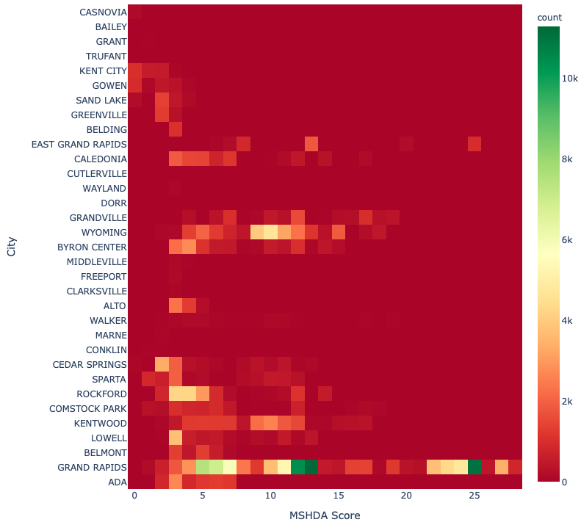
Analysis and Visualization
Distribution of properties with high MSDHA Scores
Commentary
Look at % of high scores not just absolute number (e.g. East Grand Rapids)
Take number of properties in each city, divide each bin by number of properties

Slide 8
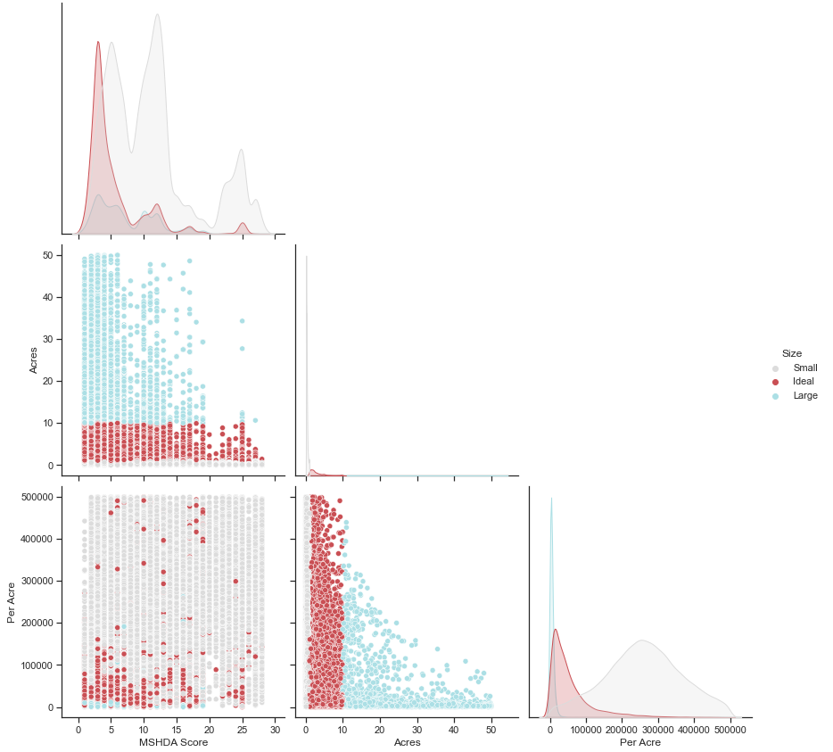
Cost vs Size vs Score
Relationship of interest

Slide 9
MSDHA score vs Cost per acre
Show a table of ideal size in a specific city and show a sample of the ideal size
> MSHDA 25
> Sorted by cost
Wyoming
Ideally sized properties in ________ with highest MSHDA scores
1422 Preston Ridge St NW, Grand Rapids, MI 49504
.
.
.
1450 Fulton St E, Grand Rapids, MI 49503

Slide 10
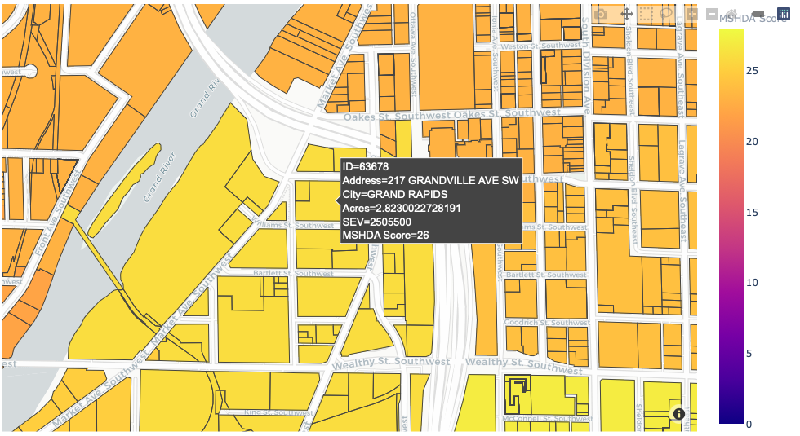
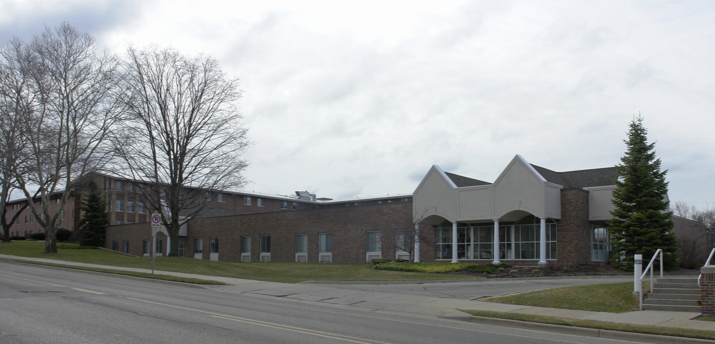
Plot level information
1450 Fulton St E, Grand Rapids, MI 49503
Map of the property in the city
High score example (25), redevelopment opportunity

Slide 11
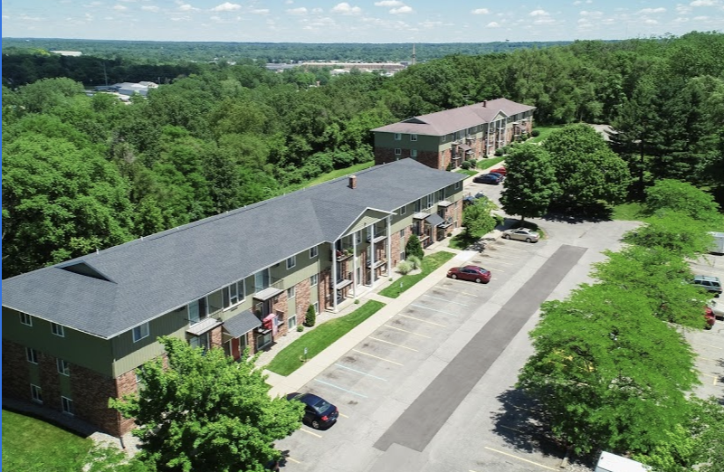
Plot level information
1422 Preston Ridge St NW, Grand Rapids, MI 49504
Map of the property in the city
Low score example (8), existing multi-family

Slide 12
Conclusion
Difficult to find right sized properties that are cheap and have high score
Our tool helps developers to find these properties more quickly and efficiently
Kent County has shapefiles. Do all counties have shapefiles? Otherwise have to obtain commercially.
Comment on supply-side only analysis … would be even more useful if demand-size could be incorporated (statistics from Alan’s proposal).

Slide 13
Problems encountered
Change this to problems encountered and move to the end just before Future Enhancements

Slide 14
Future enhancements

Slide 15
Statement of Work

Slide 16
References & acknowledgements
References
Acknowledgements

Slide 17
Python Libraries Used
Some commentary about libraries
MOVE TO JUPYTER NOTEBOOK
Libraries | Usage
Numpy and Pandas
GeoPandas
SQLalchemy
Matplotlib
Plotly
Seaborn

